Slide 1
Horace Gibson
By Gabriel Howard
Source: Shades of Gray
by Hareem Badil-Abish

Slide 2
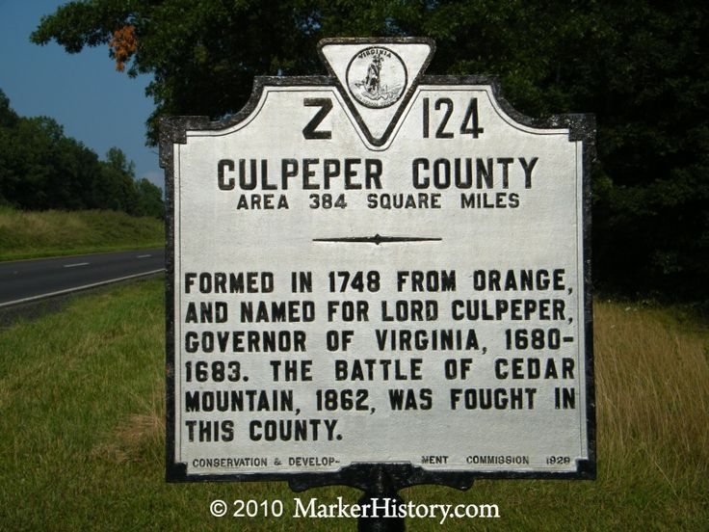
Place of Birth and Beginning
Horace Gibson was born into slavery on April 15, 1817 in Culpepper County, Virginia on the plantation of Jonathan Gibson
Horace was mixed heritage of African-American and Caucasian

Slide 3
Family Details
Married to Margaret Gibson
12 Children: Strother, Adalina, Wesley, Matilda, Brook E., Mary, John Edward, George H., Emily, Lewis, Henry, Tommie. Wow!

Slide 4
Lifetime Accomplishments
Horace Gibson was known as a highly skilled blacksmith and hired hand who was often hired out to other plantations.
Eventually, Gibson saved enough money to buy his and his wife’s freedom
Margaret and Horace left Culpepper county In the late 1860’s and purchased five acres of land in Portsmouth, Virginia with his saved earnings.
Horace’s shop with his partner Moses Parker, was located on Little River Toll Road, near the courthouse. Due to the busy location of their shop , they achieved more success than shops owned by white blacksmiths. They also had both black and white customers.
Gibson must have been a very skilled blacksmith. For two African-American people to purchase five acres of land was a big deal.

Slide 5
Notable Achievements and Impact on Today’s Society
One of the first freed African-Americans to settle and prosper in the village of Ilda.
Created an access road in present day Merrifield, Virginia. This road, known as Prosperity Avenue, gave increased access to his business and his son’s land. This road also increased access to other lands owners land who previously had no access road.
By the late 1890’s Gibson and his partner Moses shared a combined property holding in excess of 400 acres!
At this time this was a major accomplishment for African-Americans due to racism and inequity.

Slide 6
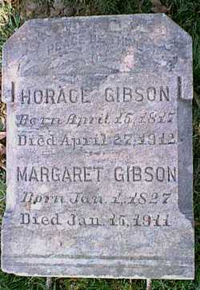
Death
Horace Gibson died on April 27, 1912.
He is buried at Jermantown Cemetery along with his wife Margaret.

Slide 7
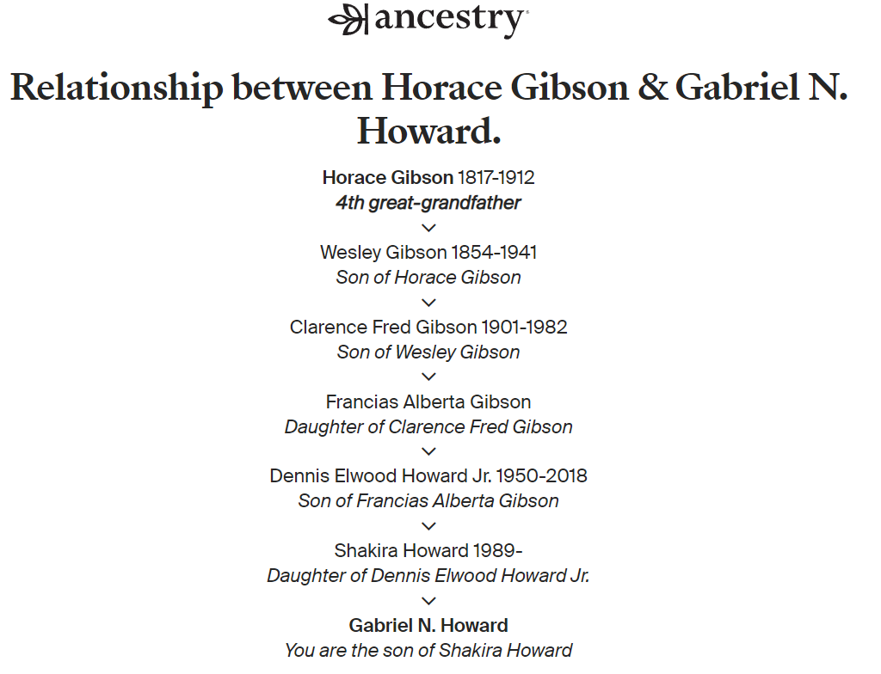
Thank You
Author, 4th great grandson of Horace Gibson

